Slide 1

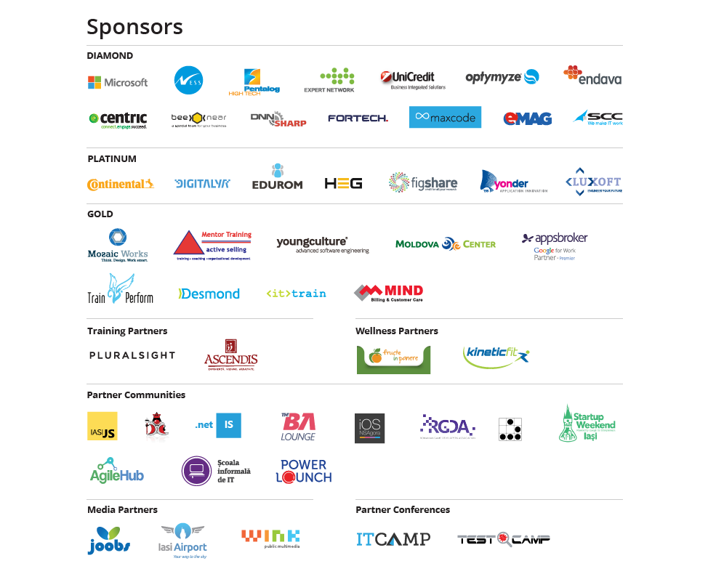

Slide 2
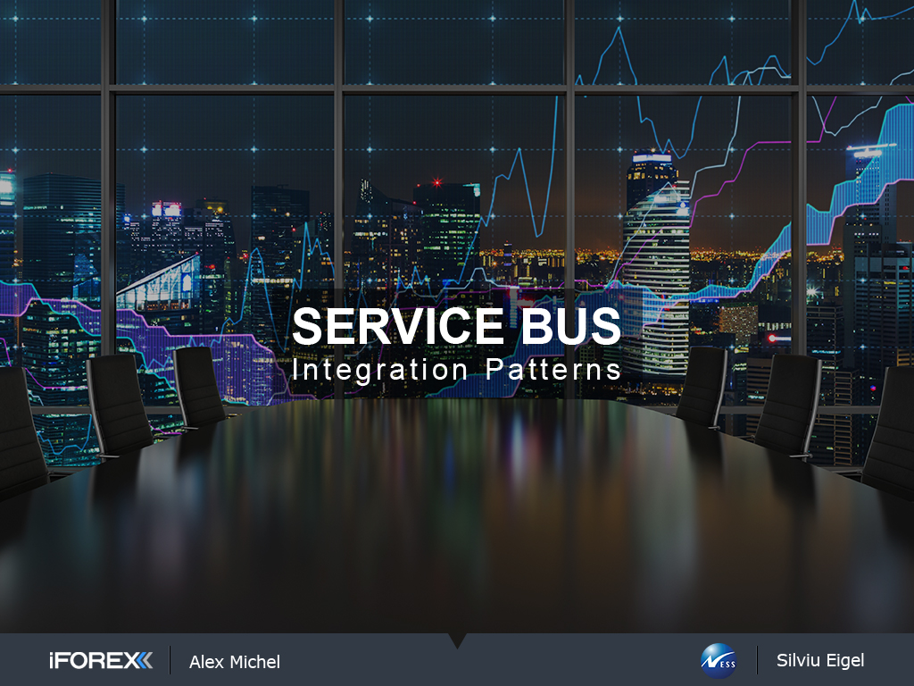

Slide 3
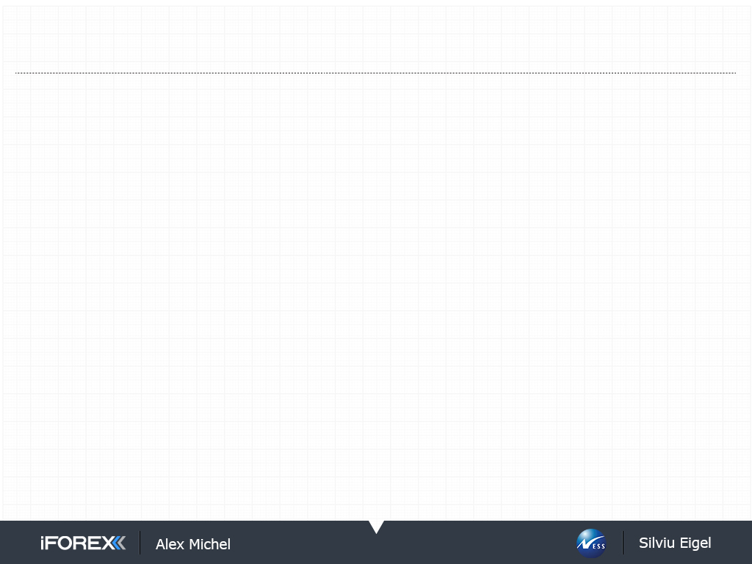
Agenda
Mass Transit
Mass Transit Project
Messaging Patterns
Feature Map
Legacy System
Architecture
Problems
More
Explore
Read
Hack
Solution
Architecture
Code
Scale Out and Cloud Deploy

Slide 4
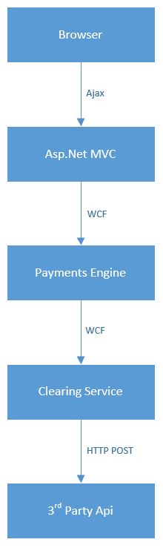
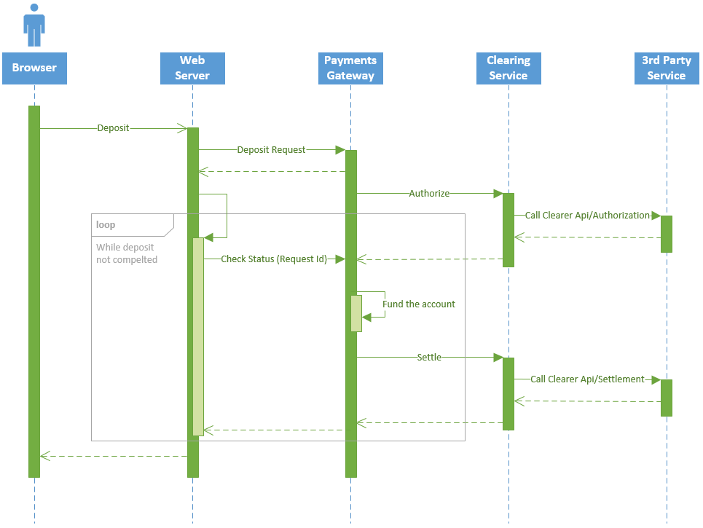
Legacy System Architecture

Slide 5
Legacy System Problems
Not Scalable
Hard to split into independent functional parts
Impossible to scale out core components
Explicit low-level thread synchronization
No Resiliency
Single point of failure
No means of transparent failover
Waste of Resources
Synchronous Requests
Active Connections
Busy Waiting
Background Threads
Tight Coupling
Strict imperative flow control code
Components interact via interfaces/abstract classes
Not Cloud Ready
These properties make cloud deployment impractical

Slide 6
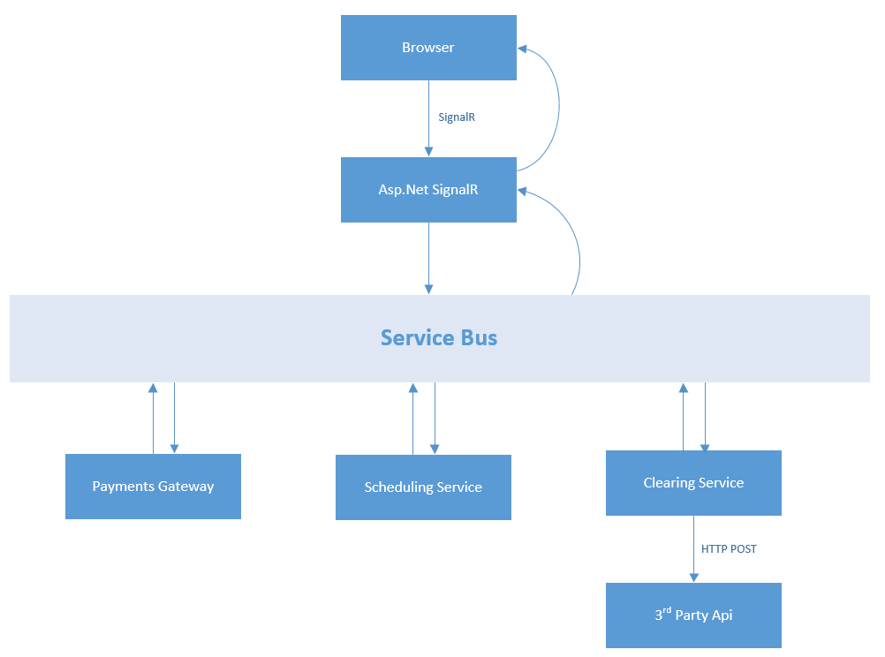
Solution Architecture

Slide 7
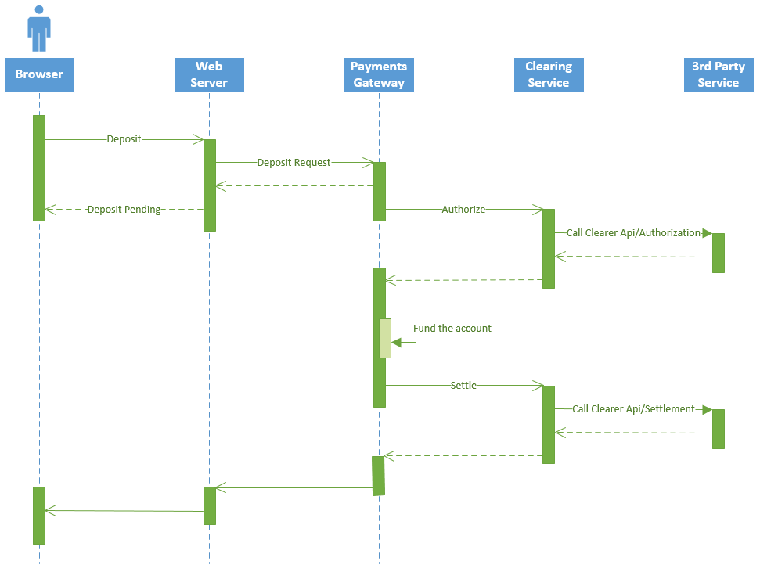
Solution Architecture

Slide 8

MassTransit
MassTransit is a free, open-source service bus and distributed application framework for .NET
MassTransit
Automatonymous
Courier
TopShelf
Quartz
Transports
Persistence
RX

Slide 9
MassTransit
Infrastructure
Configuration
Flow Control
Correlation
Messaging Patterns
Request/Response
Other
Testing Library
Transports
Encryption
Lifetime
Serialization
Retry Policy
Scheduling
Dead Letter
Circuit Breaker
Pipes and Filters
Monitoring
Persistency
Routing
Publish/Subscribe
Saga
Error Handling
Composite Events
Transforms
Versioning
Compensations
Routing Slip
State Machines
Middleware
Community
Attachments
Hosting

Slide 10
Messaging Patterns
Request/Response
Request Queue
Responder
Requestor
Reply
Queue
Publish/Subscribe
Subscriber
Queue
Publisher
Subscriber
Queue

Slide 11
Messaging Patterns
Saga
“A Saga is a Long Lived Transaction that can be written as a sequence of transactions that can be interleaved.
Transactions in the sequence complete successfully or compensating transactions are ran to amend partial execution.”
Distributed Sagas in MassTransit can be implemented with custom logic or using Automatonymous state machine, which is now part of the core project.
MassTransit takes care of correlation, transport bindings, compensations, timeouts, faults, persistency, state machine execution.
Using MassTransit Saga one can implement classical Saga - a sequence of transactions and compensations as well as other patterns like Process Manager or other models of distributed flow coordination.
Compensation
T₁
Success
T₂
Fault/Timeout
C₂
Success
C₁
Compensation

Slide 12
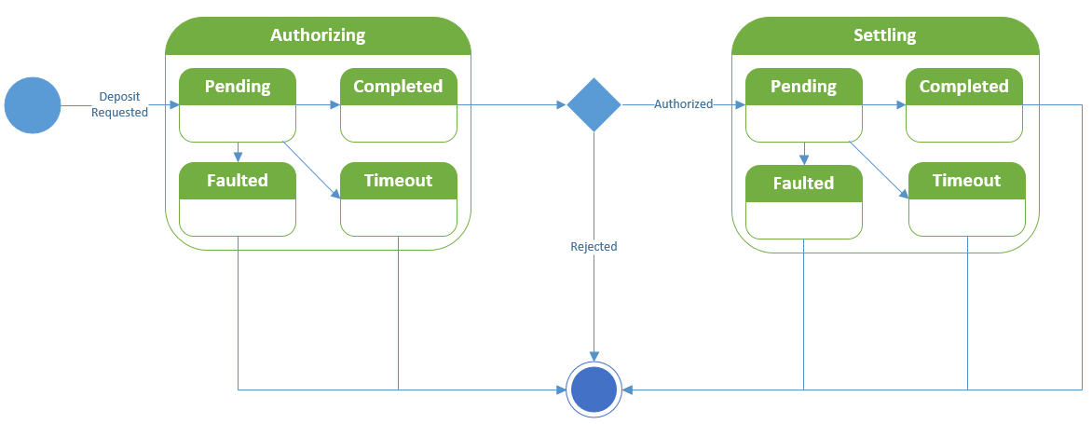
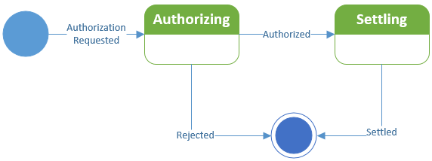
Solution Architecture

Slide 13
Demo – at last!

Slide 14
Not Covered in Demo
Persistency
Complex Compensations
Versioning
RabbitMQ and Azure SB
Community Middleware
Many Other…

Slide 15
Wait a Minute! You promised:
Scalability
Resiliency
Cloud Support

Slide 16
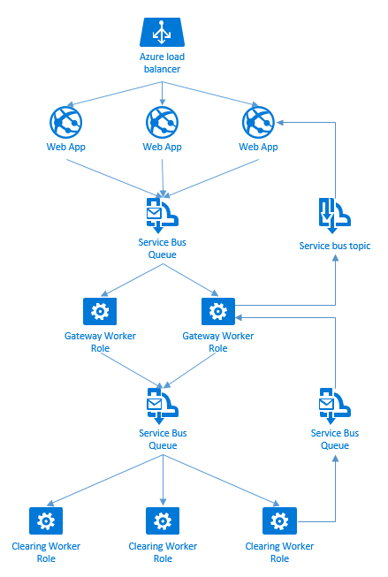
Cloud Deployment
Deploy and scale out in Azure
Scale frontend with load balancer
Use Azure Service Bus as Transport
Scale backend with Competing Consumers and PubSub
Use metrics for auto-scaling policy (e.g. receiving queue size)

Slide 17
Read:
https://media.readthedocs.org/pdf/masstransit/latest/masstransit.pdf
https://msdn.microsoft.com/en-us/library/dn600223.aspx
Explore:
https://github.com/MassTransit/MassTransit
https://github.com/amichel/PaymentsGateway.MassTransit.Demo
Hack
Questions?

Slide 18


